Slide 1
Chain-of-Memory: Lightweight Memory Construction with Dynamic Evolution for LLM Agents
Presenter：Jin Huihui
July 2-7, 2026 ©2026 Association for Computational Linguistics

Slide 2
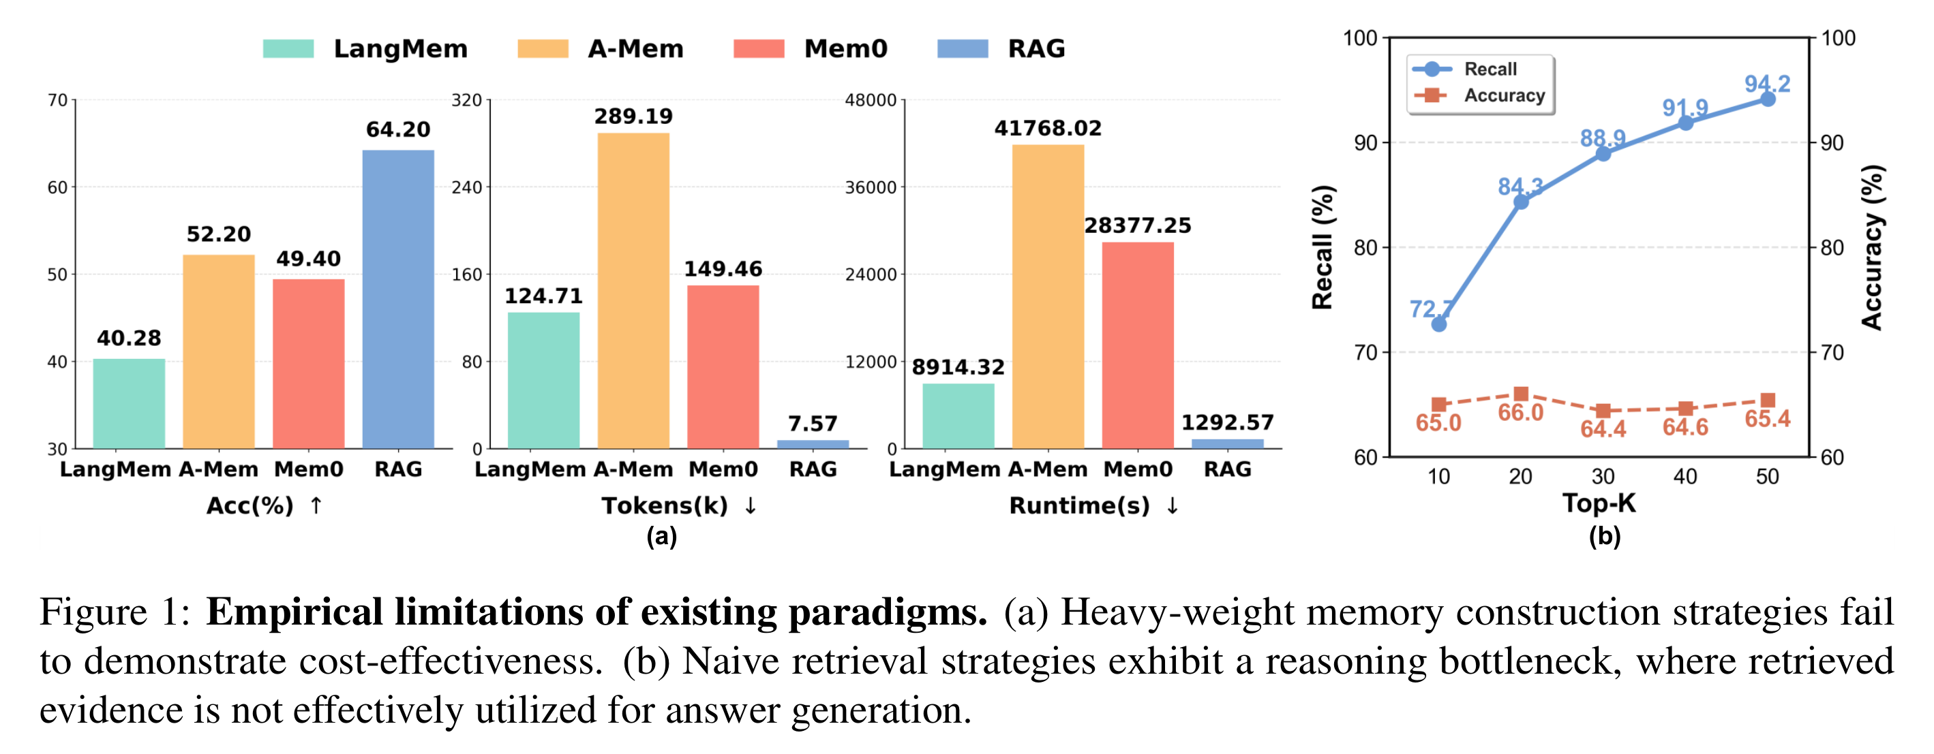
Empirical Limitations of the Existing Paradigm
(a) Expensive Construction: Complex structures (e.g., graphs/trees) incur high costs with marginal benefits.
(b) Naive Utilization: Retrieved fragments are merely concatenated into prompts without logical structures.

Slide 3
Core Claim and Contributions
CoM(Chain-of-Memory)
A Paradigm Shift to Lightweight Construction paired with Systematic Dynamic Utilization.
Memory Construction and Retrieval
Dynamic Memory Chain Evolution
Rapid access via semantic similarity (Top-K).
Avoids the heavy burden of graph/tree-based modeling.
Retrieved fragments organized into coherent inference paths.
Adaptive truncation prunes irrelevant noise.
Accuracy gains 7.5%–10.4%
Cost drops to ~2.7% tokens and 6.0% latency

Slide 4
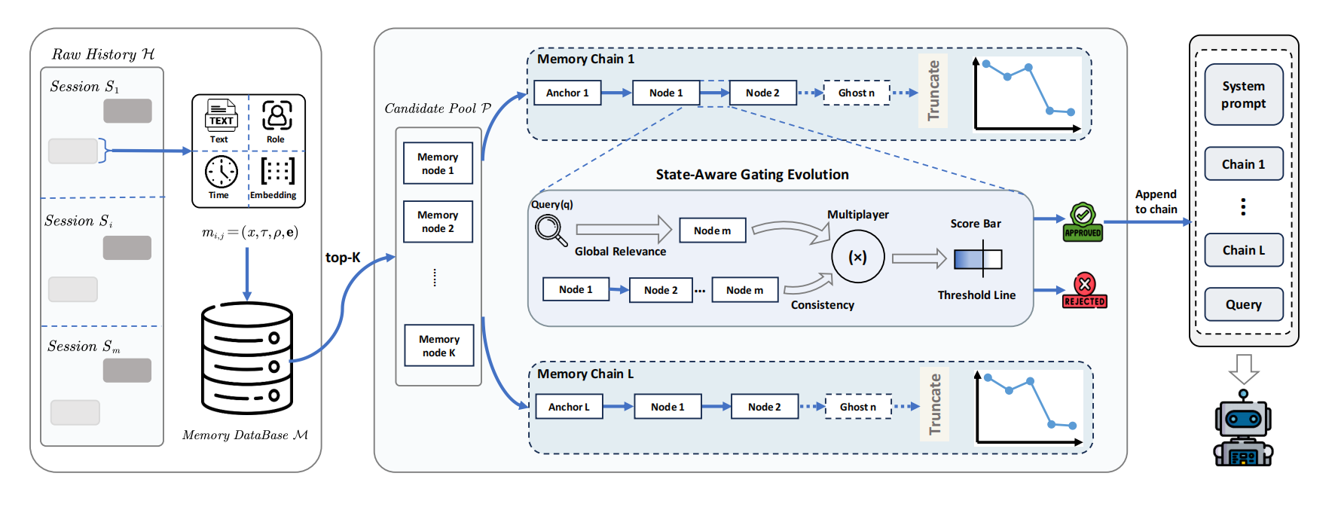
CoM Framework Overview

Slide 5
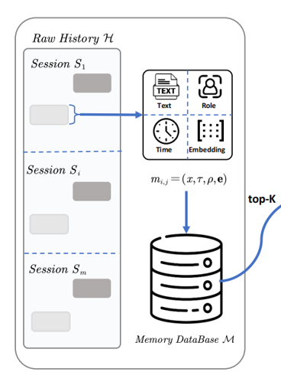
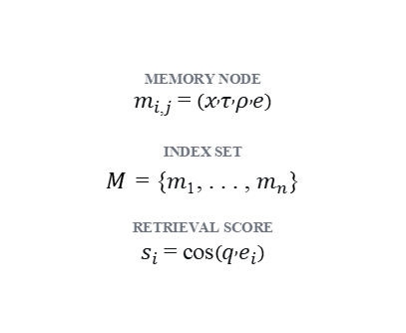
Stage 1: Lightweight Memory Construction and Retrieval
NOTATION
MEMORY NODE
$$m_{i,j}=\left(x , τ , ρ , e\right)$$
INDEX SET
𝑀 = {$m_{1}$, . . . , $m_{n}$}
RETRIEVAL SCORE
$$s_{i}=cos\left(q , e_{i}\right)$$

Slide 6
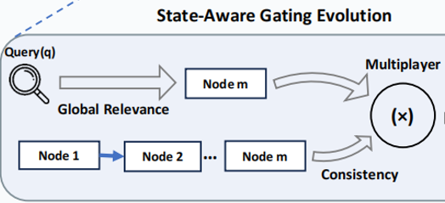
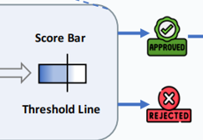


Stage 2: Dynamic Memory Chain Evolution
Top-L nodes anchor L independent memory chains.
门控分数
$$S_{gate}\left(m\right)=cos\left(m , q\right)×cos\left(m , C_{z}^{\left(t\right)}\right)$$
global relevance × contextual consistency
自适应截断
$$s_{t}^{∗}<β⋅s_{t−1}$$
sharp attenuation halts expansion; β = 0.5

Slide 7



Complexity and Efficiency Design
L条链的最坏情况复杂度
$$O\left(LK^{2}d\right)$$
K be the size of the retrieved candidate pool
if truncation never triggers
L be the number of initialized memory chains
d be the embedding dimension
若设置最大链长 T
One chain scans at most $\sum_{t=1}^{K−1}{\left(K−t\right)}$ candidates → $O\left(K^{2}d\right)$ vector operations.
$$O\left(LTKd\right)$$
where T ≤ K

Slide 8
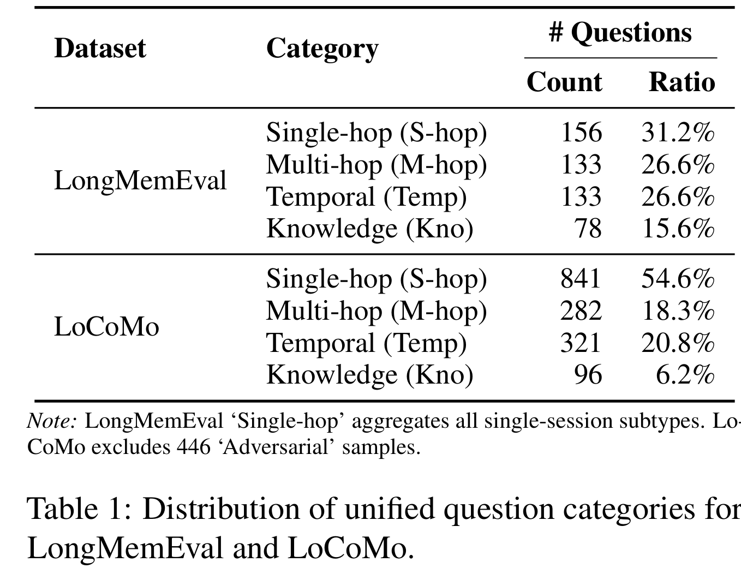
Experimental Setup
LongMemEval 500 QA; average context ≈115k tokens.
LoCoMo 1,986 QA; average ≈26k tokens; 446 Adversarial excluded.
Tasks four unified categories: single-hop, multi-hop, temporal, knowledge.
Baselines Full Context, Naive RAG, LangMem, A-Mem, Mem0.
Metrics ACC, Token, Runtime; backbones GPT-4o-mini and Qwen3-32B.

Slide 9
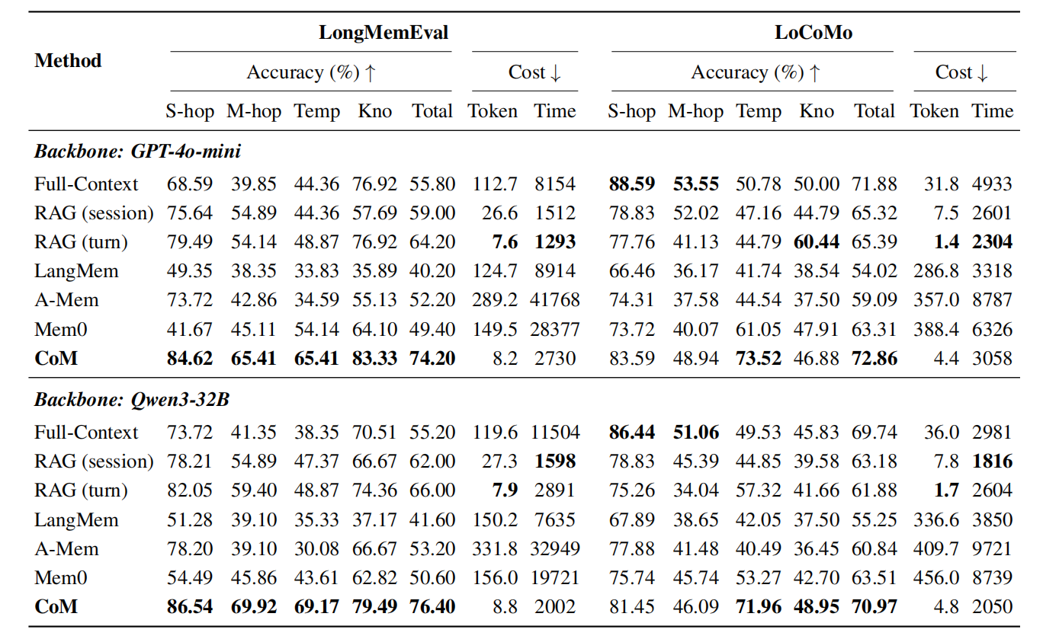
Main Results: Accuracy

Slide 10
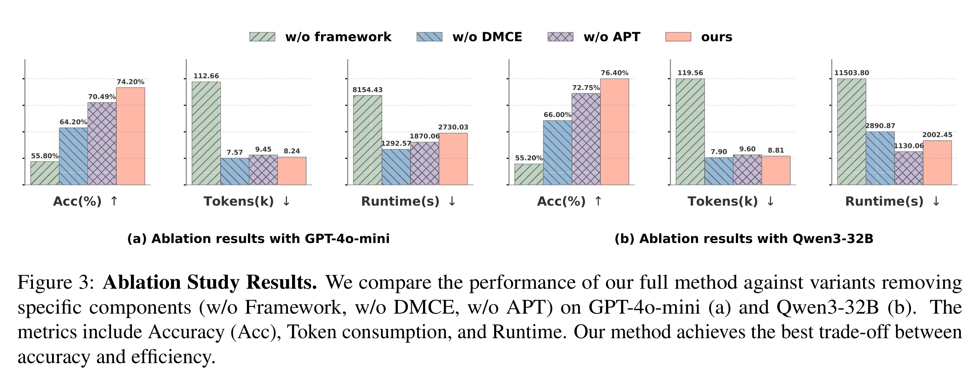
Ablation: Framework Components
w/o Framework (Full-Context) w/o DMCE (RAG-turn) w/o APT (No Truncation)

Slide 11
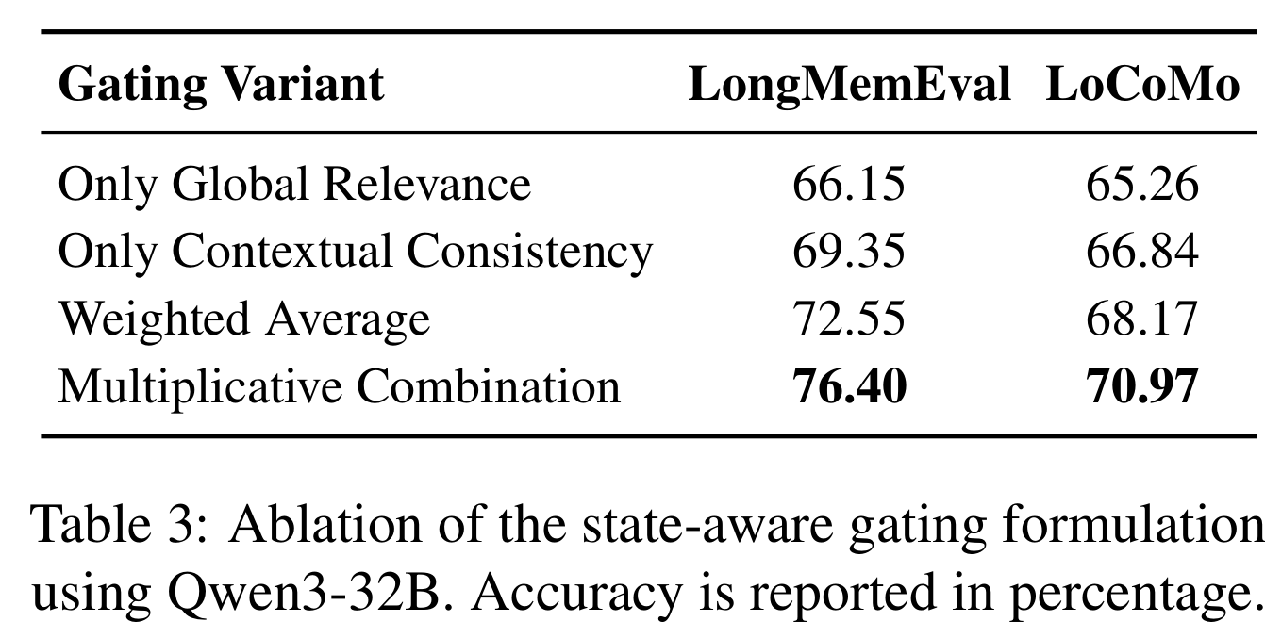
Ablation: Gating Formulation
门控分数
$$S_{gate}\left(m\right)=cos\left(m , q\right)×cos\left(m , C_{z}^{\left(t\right)}\right)$$
global relevance × contextual consistency

Slide 12
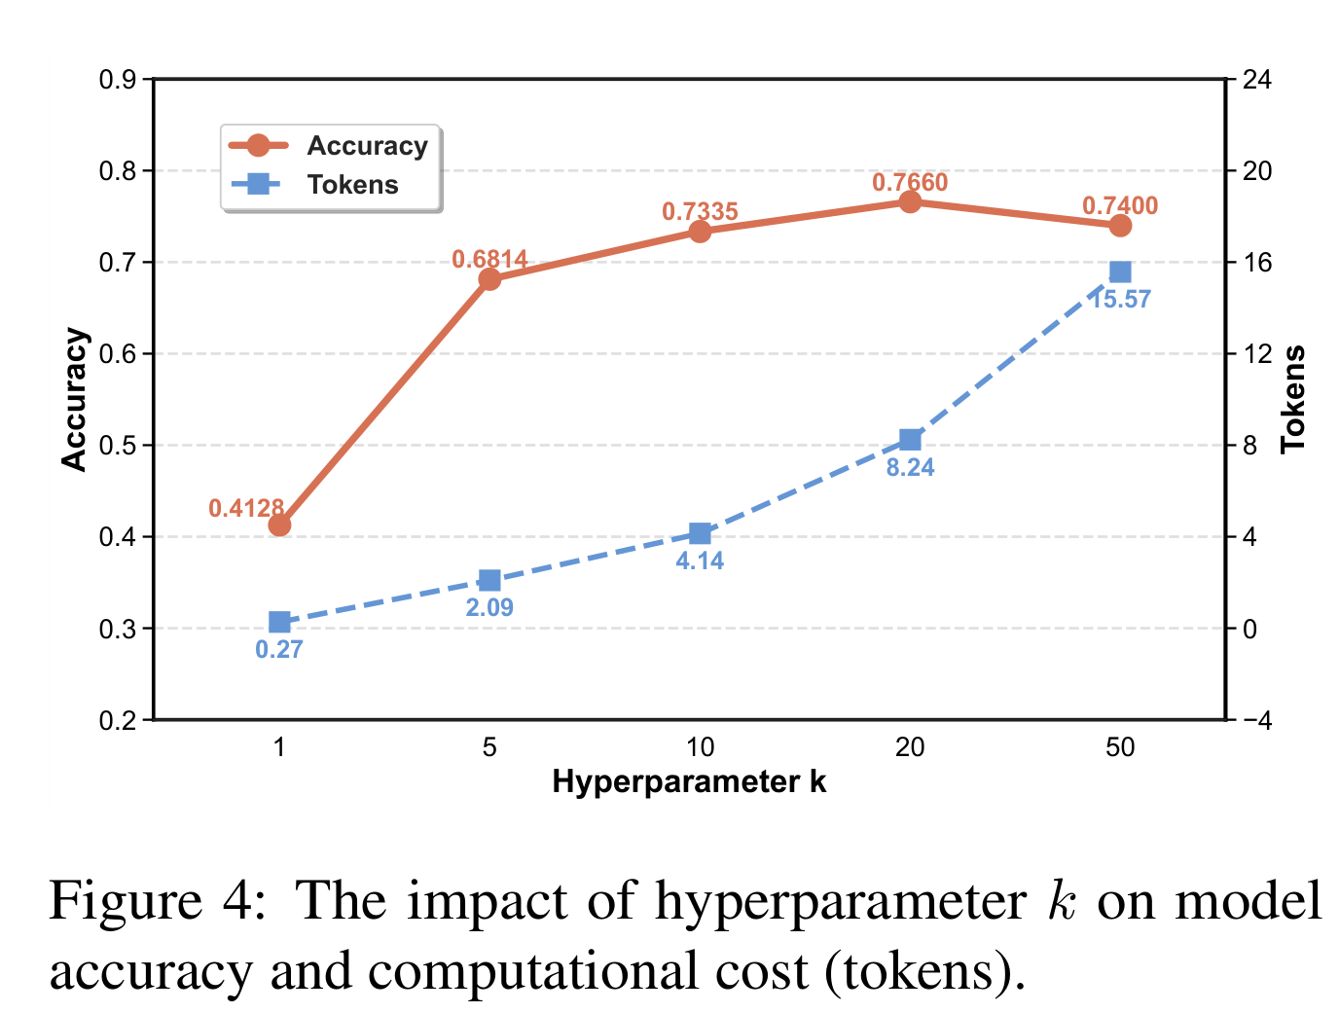
Hyperparameter: Retrieval Size k
k ∈ {1, 5, 10, 20, 50}.
Runtime is dominated by LLM inference and network overhead.

Slide 13
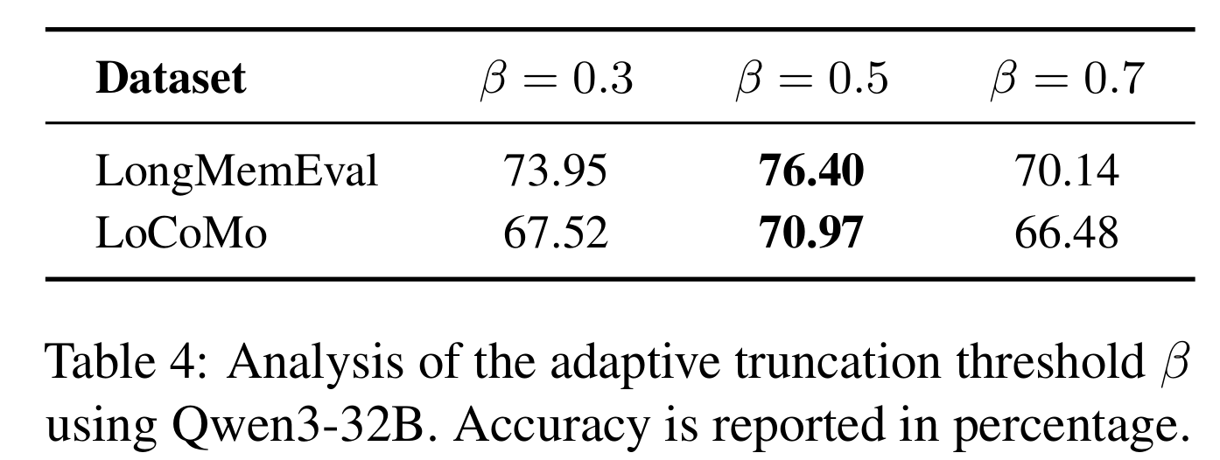
Hyperparameter: Truncation Threshold β
β = 0.3 / 0.5 / 0.7.
Too small under-truncates; too large stops expansion too early.
自适应截断
$$s_{t}^{∗}<β⋅s_{t−1}$$
sharp attenuation halts expansion;

Slide 14
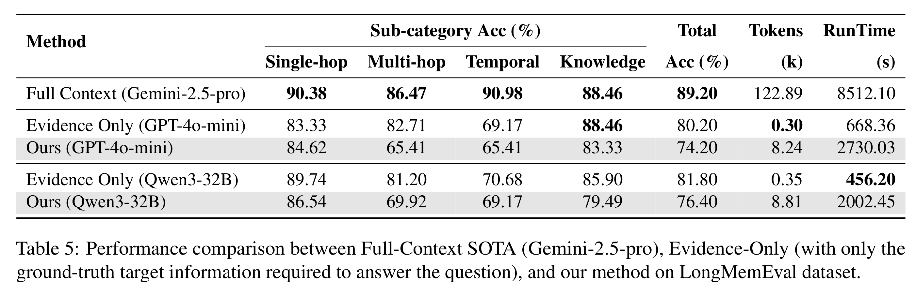
Upper-Bound Analysis
Baselines Full context, Evidence Only.
CoM 76.40% approaches the reasoning ceiling.
vs Gemini: ≈14× fewer tokens and ≈4× lower latency.

Slide 15
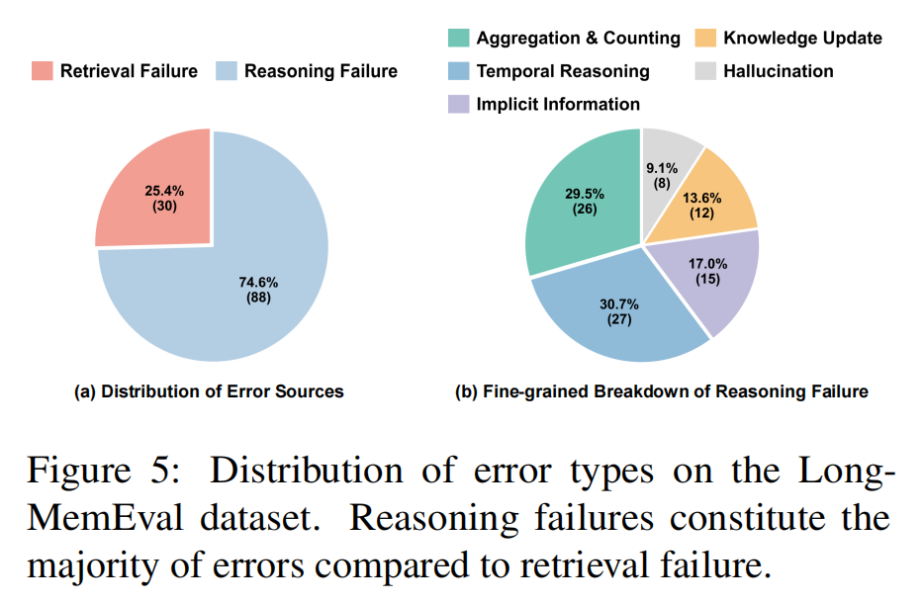
Error Analysis

Slide 16
Conclusion and Limitations
Conclusion
Lightweight construction + dynamic memory chain + adaptive truncation bridge the gap between retrieved evidence and reasoning.
Effective agent memory does not require increasingly complex construction.
Limitations
Relies on embedding-based semantic similarity.
Truncation may discard weak long-chain evidence.
Textual memory only; multi-modal and open environments remain for future work.

